Slide 1
Amazon Aurora vs Azure SQL
Price comparison

Slide 2
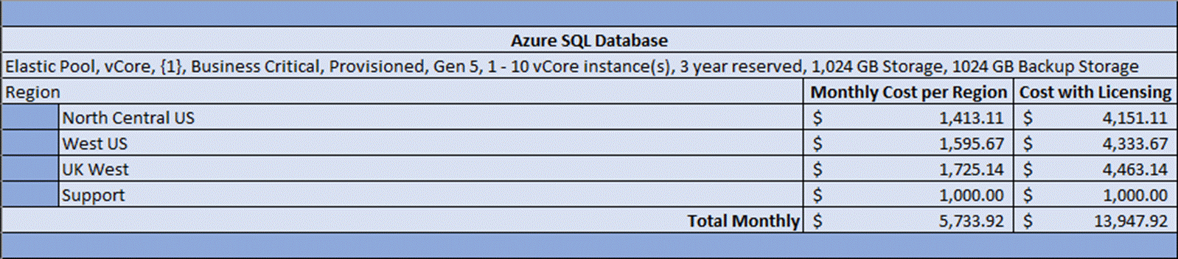
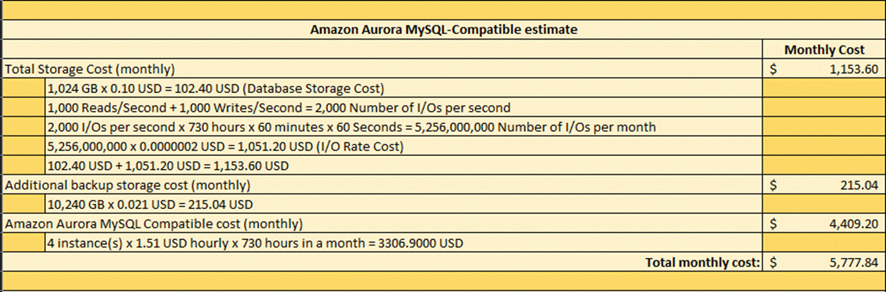
Original Estimation

Slide 3
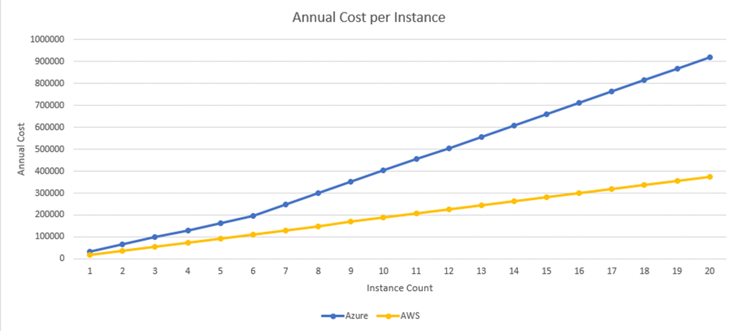
Naturally

Slide 4
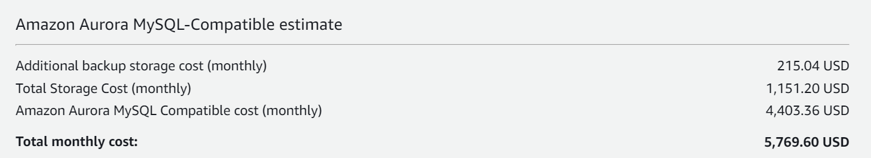
Peter’s Estimation
Microsoft Azure Estimate
Azure SQL Elastic Pool
Service type | Region | Description | Estimated monthly cost | Estimated upfront cost
Azure SQL Database | Central US | Elastic Pool, vCore, {1}, Business Critical, Provisioned, Gen 5, 4 - 10 vCore instance(s), 3 year reserved, 1,024 GB Storage, 1024 GB Backup Storage | $5,229.98 | $0.00
Support |  | Support | $1,000.00 | $0.00
 |  | Licensing Program | Microsoft Online Services Agreement
 |  | Total | $6,229.98 | $0.00
Notes:
Azure Estimation
https://azure.com/e/085fd7a7c2af4f8da53a9db5bd629406
AWS Estimation
https://calculator.aws/#/estimate?id=7f1b47bc1c8ea0522fec05443020f43c296d655d

Slide 5
Azure vs AWS, with and w/o Support plan

Slide 6
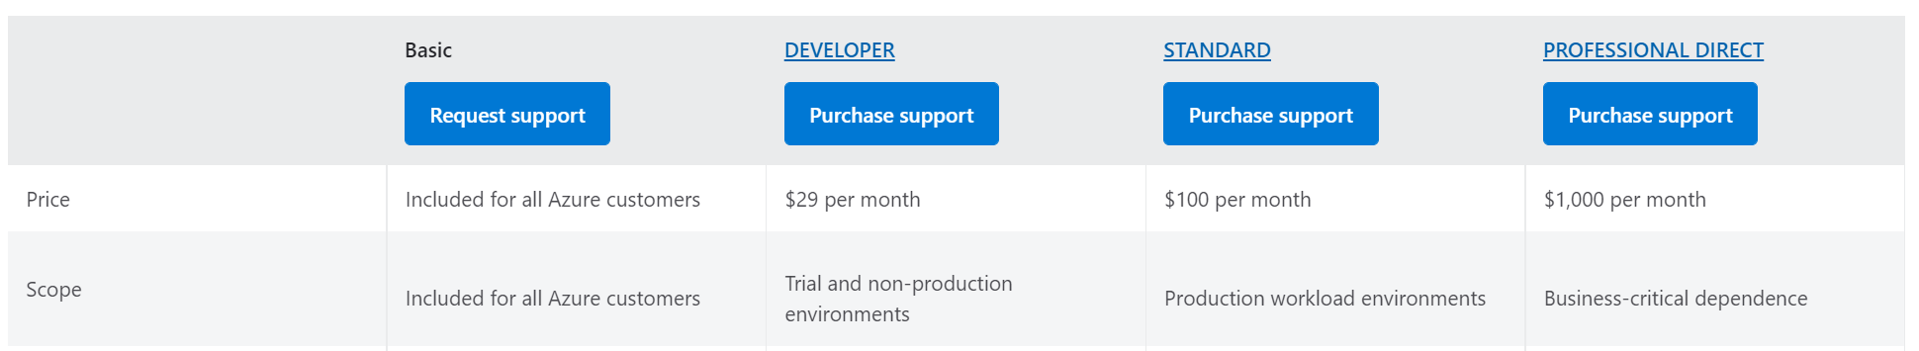
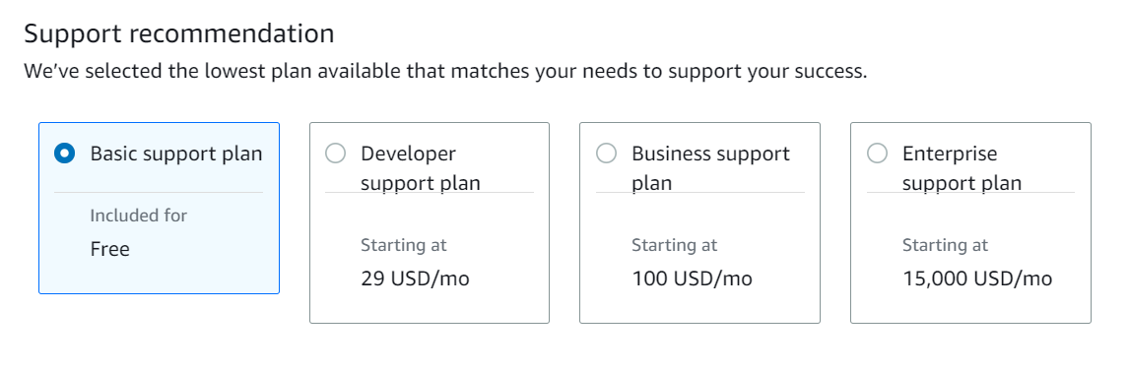
Support prices…
Azure Support
AWS Support
Notes:
https://azure.microsoft.com/en-us/support/plans/
https://calculator.aws/#/support

Slide 7
With Support included

Slide 8
Aurora vs Azure SQL
Aurora is proprietary forked MySQL. Migration will be needed for onboarding and offboarding
No In-Memory technology
No Intelligent Query Processing
No ML-based advisors on query processing (30-40% productivity gains)
No Enterprise Security Features
No Transparent Data Encryption (TDE)
No Always Encrypted
No Dynamic Data Masking
No ML Based security protection in the cloud
Notes:
MS SQL started in 1989 with Sybase.
Split from Sybase and released MS SQL Server 6.0 in 1995.
https://en.wikipedia.org/wiki/History_of_Microsoft_SQL_Server

Slide 9
MS SQL is not MySQL.
Azure SQL is Microsoft own SQL Server
AWS Aurora is SAASified MySQL (formerly OSS, owned by Oracle)
Single Vendor
Cross Service Compatibility and integration
Readiness
Technology Maturity
Enterprise Readiness
Replication
Internal Competencies

Slide 10
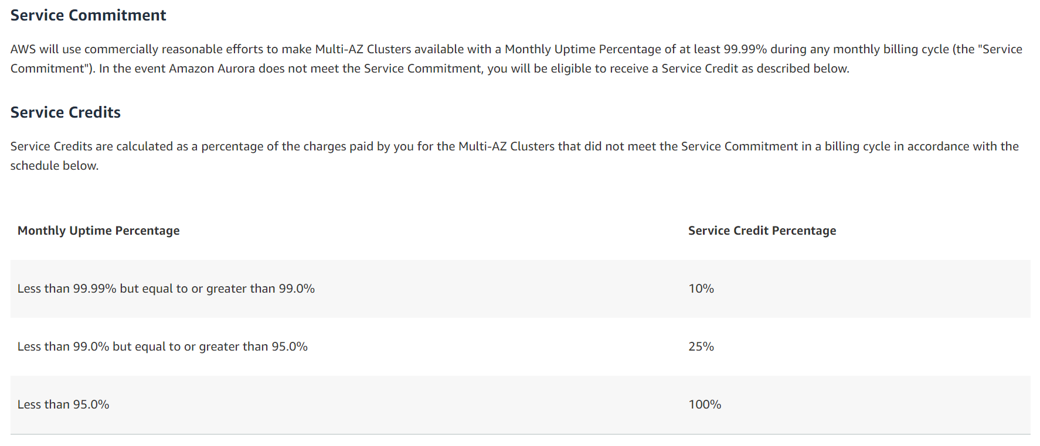
AWS Aurora SLA
Notes:
AWS
https://aws.amazon.com/rds/aurora/sla/

Slide 11
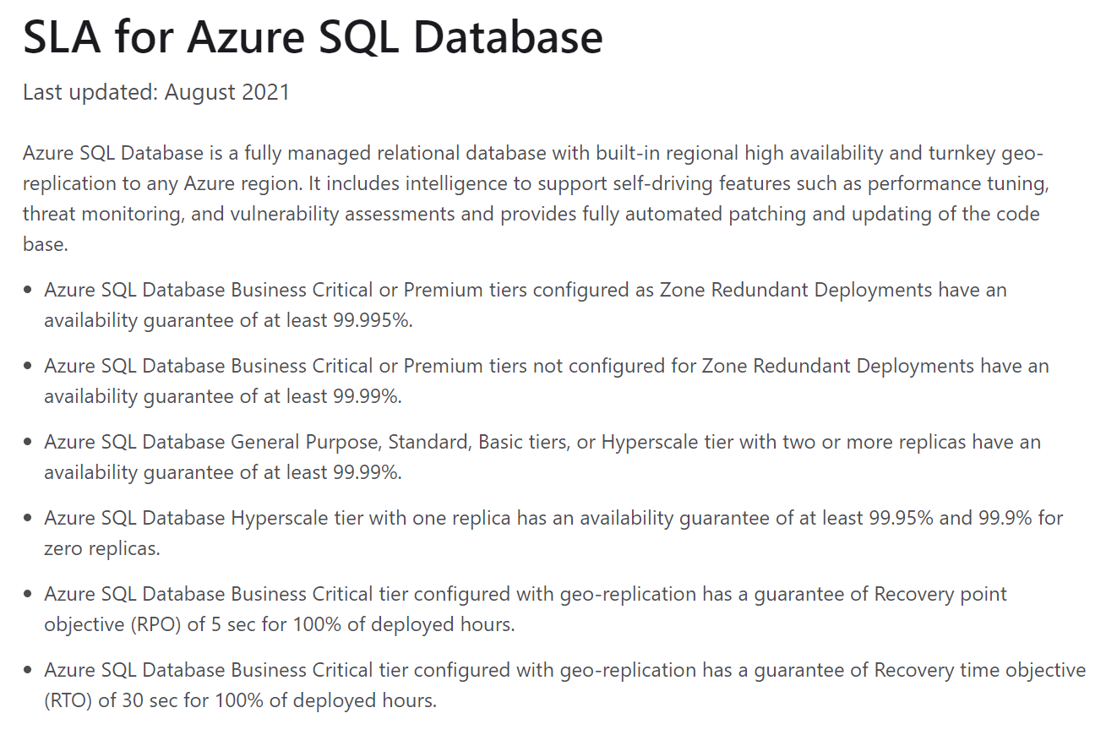
Notes:
https://azure.microsoft.com/en-us/support/legal/sla/azure-sql-database/v1_6/

Slide 12
SLA: AWS vs Azure SQL
AWS will use commercially reasonable efforts to make Multi-AZ Clusters available with a Monthly Uptime Percentage of at least 99.99% during any monthly billing cycle (the "Service Commitment"). In the event Amazon Aurora does not meet the Service Commitment, you will be eligible to receive a Service Credit as described below.
Azure SQL Database Business Critical or Premium tiers configured as Zone Redundant Deployments have an availability guarantee of at least 99.995%.
Azure SQL Database Business Critical or Premium tiers not configured for Zone Redundant Deployments have an availability guarantee of at least 99.99%.

